Slide 1
Data Mining
Group: 12
Group members:
1. Ngô Minh Đại - 1913008
2. Trần Như Anh Vũ - 1752632
3. Nguyễn Hải Đăng - 1952652
4. Nakamura Ryuta - 1752004

Slide 2
Do you like stock?

Slide 3
Do you know how to investigate in stock efficiently?

Slide 4
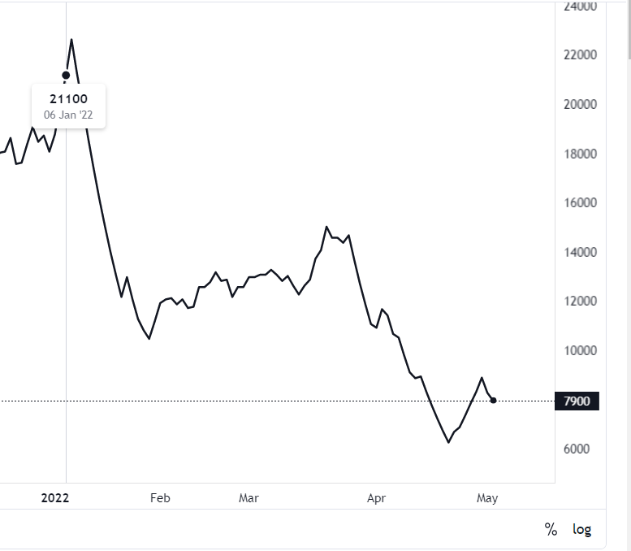

Slide 5
Data Mining
Stock Selection Using Association Rules on Cash Flow and Accrual Financial Indicators
Group: 12
Group members:
1. Ngô Minh Đại - 1913008
2. Trần Như Anh Vũ - 1752632
3. Nguyễn Hải Đăng - 1952652
4. Nakamura Ryuta - 1752004

Slide 6
Outline
Introduction and related work
Method
Experimental design, results and discussion
Demonstration
Conclusion
Kahoot

Slide 7
Methodology
In this study, ARM algorithm apply on stock data set, finding the relationship among stock variables open price, high price, low price and close price and generating the rules with these variables of TCS index
The data set encompassed the trading months from 1-1-2006 to 30-12-2011
The task is to predict the stock prices of TCS Company will be up or down from today to tomorrow by using the past values of company stock. The stock market data sample is given by Table 1

Slide 8
Open price
Close price
is the price at which a security first trades when an exchange opens for the day.
is the last price at which a security traded during the regular trading day.
High price
Low price
is the highest price at which a stock is traded during a period.
is the lowest price at which a stock is traded during a period.

Slide 9
Month | Open | High | Low | Close
Jan-06 | 1189 | 1258 | 1169 | 1251
Feb-06 | 1255 | 1301 | 1230 | 1295
… | … | … | … | …
Oct-11 | 2012 | 2168 | 1948 | 2156
Nov-11 | 2141 | 2163 | 1881 | 1953
Dec-11 | 2212 | 2304 | 1715 | 2190
Table 1. Sample of Stock Dataset

Slide 10
S.NO | Variable | Symbolic Conversion
1 | Open | { Open_rise, Open_fall }
2 | High | { High_rise, High_fall }
3 | Low | { Low_rise, Low_fall }
4 | Close | { Close_rise, Close_fall }
Table 2. Symbolic Conversion of Stock Data Set

Slide 11
 | Open Price | High Price
 | Lies between (1030-2665) | Lies between(1141-2777)
Average | 1875 | 1972
 | Open fall(1030-1866) | High fall(1141-1952)
 | Open rise(1875-2665) | High rise(1985-2777)
 | Low Price | Close Price
 | Lies between (922-2513) | Lies between(1045-2657)
Average | 1752 | 1879
 | low fall(922-1725) | Close fall(1045-1855)
 | Open rise(1785-2513) | High rise(1895-2657)
Table 3. Data Classification of Open and High Price
Table 4. Data Classification of Low and Close Price

Slide 12

Suggestion method

Slide 13

Paper improvement
Won’t need to wait for yearly financial ratios, cash flow.
May predict the stock price for the near future in the most accurate way

Slide 14
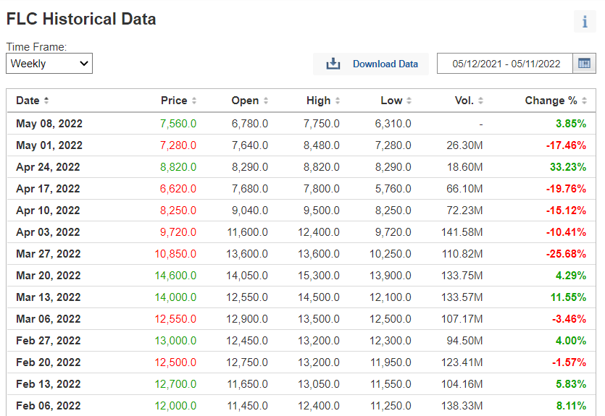
Suggestion method

Slide 15
Suggestion Method
Predicting stock price movements based on recent historical information and groups of related stocks.

Slide 16
How to know the related stocks?

Slide 17

FLC
ROS
HAI
KLF
ART

Slide 18
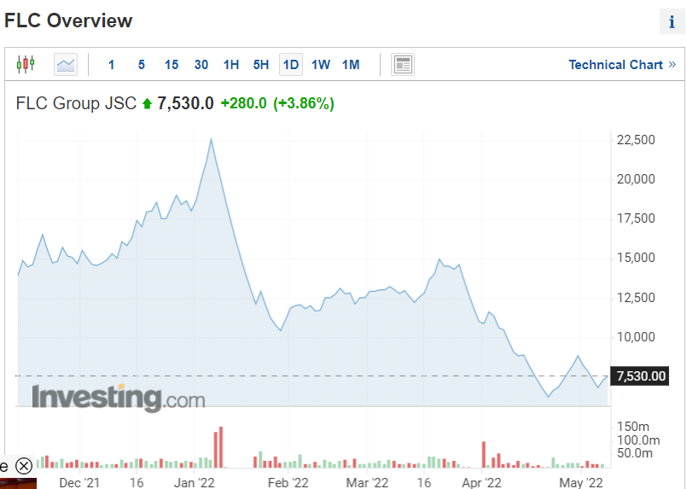
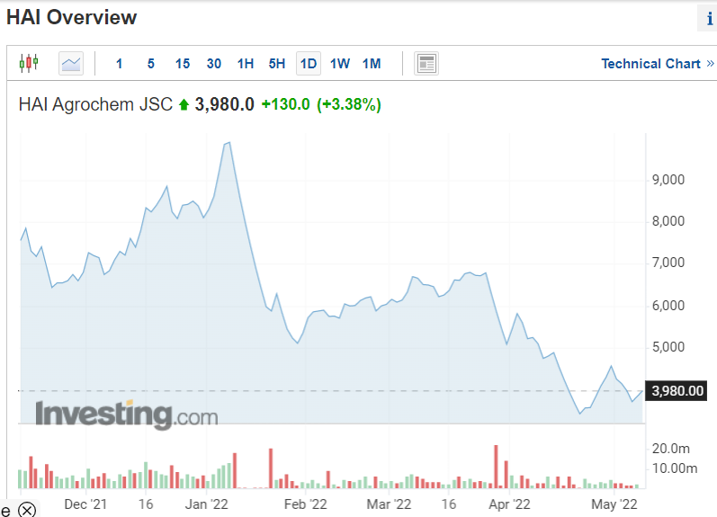
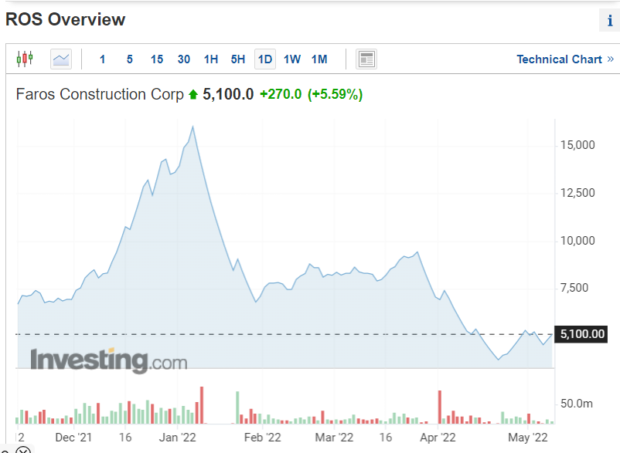
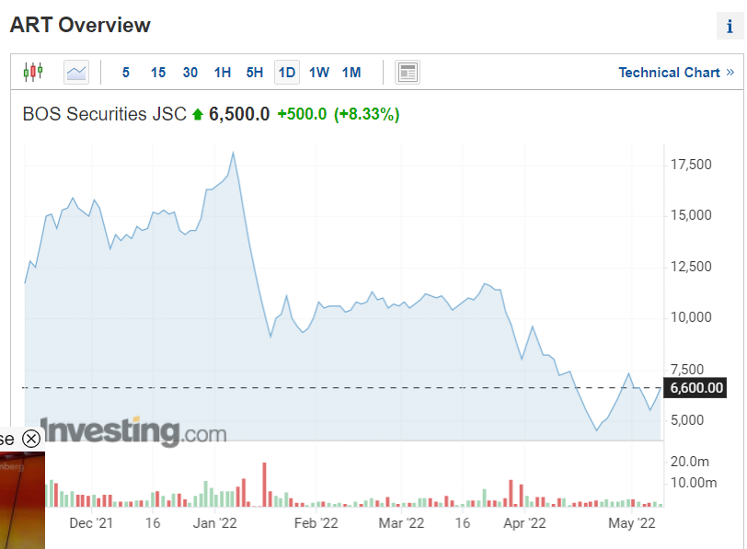
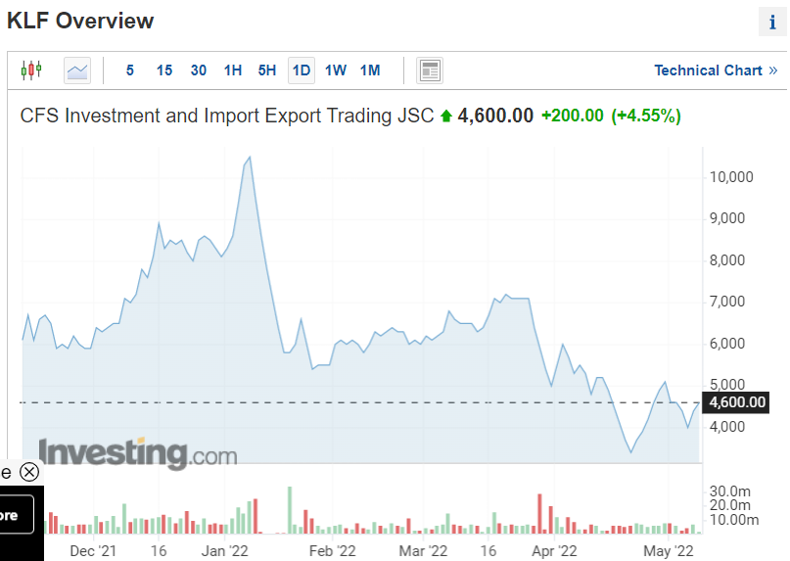

Slide 19
Date (Per week) | Change (%)
Jan 02, 2022 | 25.28%
Jan 09, 2022 | -28.60%
… | …
Apr 24, 2022 | 33.23%
May 01, 2022 | -17.46%
May 08, 2022 | 3.16%
Date (Per week) | Change (%)
Jan 02, 2022 | Rise
Jan 09, 2022 | Fall
… | …(maybe Stable)
Apr 24, 2022 | Rise
May 01, 2022 | Fall
May 08, 2022 | Rise
Input (FLC historical price information)
Transform data

Slide 20

Assume that
FLC0: is last week
FLC1: is this week
FLC2: is next week

Slide 21
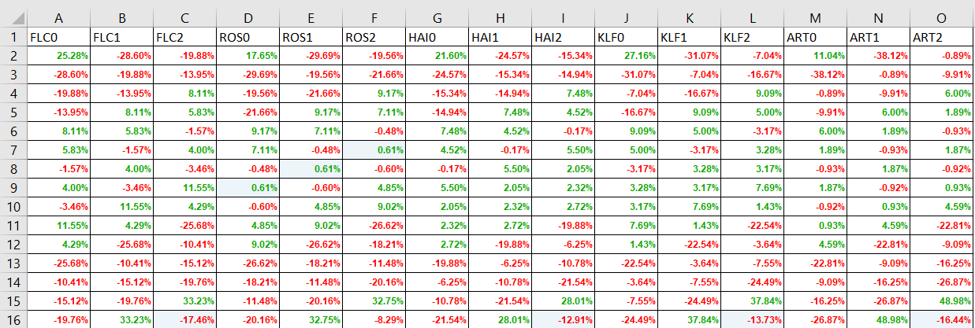

Slide 22
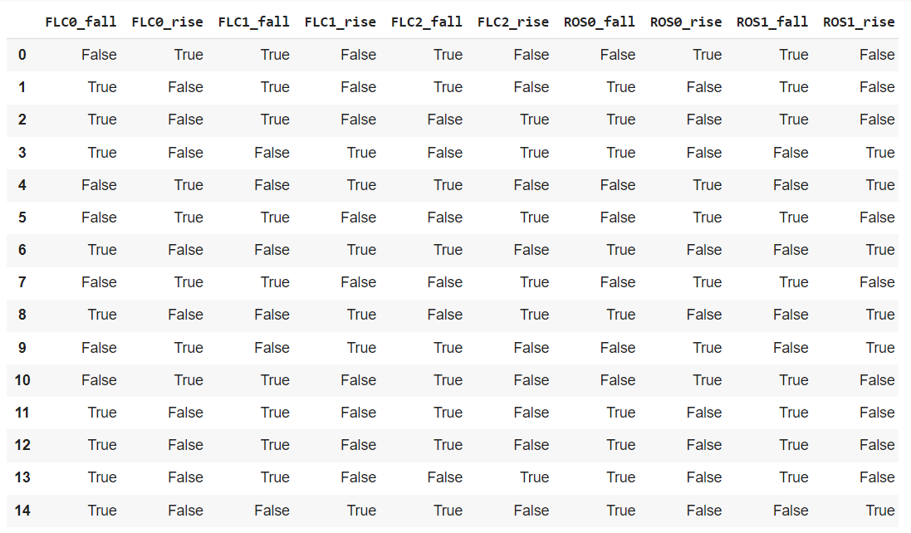

Slide 23
Apply association rule Apiori

Slide 25

Conclusion
There are many ways to invest in stock effectively if you like:
Long-term investment
Swing Trading

Slide 26
Thank you for listening
Q&A section

